Slide 1
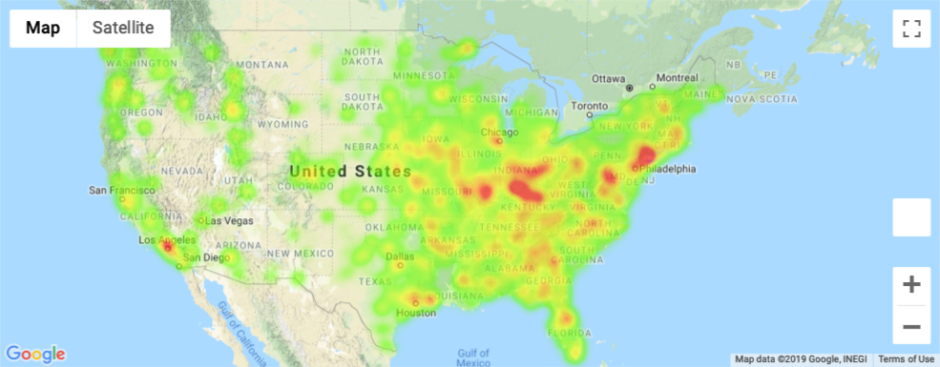
Slide 1
Ethnicity of Heart Disease
Preeya Dahya
Adam Feldstein Peter Myers
Washington University Data Science Bootcamp

Slide 2
Slide 2
The Ugly Truth
Leading cause of death
Over 600,000 deaths per year
Over 700,000 heart attacks
Multifactorial
Diabetes
Obesity
Diet
Sedentary Lifestyle
Excessive alcohol consumption
Family History
www.cdc.gov
2

Slide 3
Slide 2
Our Question
What does heart disease look like across the US?
3

Slide 4
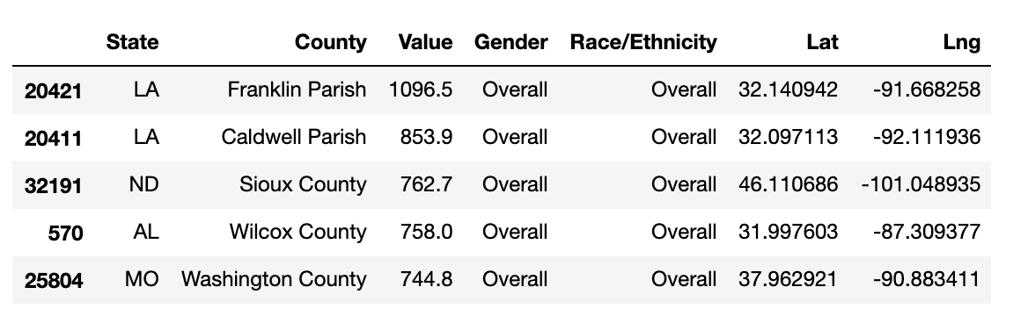
Slide 2
The Data Cleaning
“Heart Disease Mortality Rate Among US Adults (35+)”
32,000 columns
Rows: State, County, Lat/Lng, Gender, Race, & Deaths
Steps
Removed all counties with empty data
Separated by county
Separated by Each race
5

Slide 5
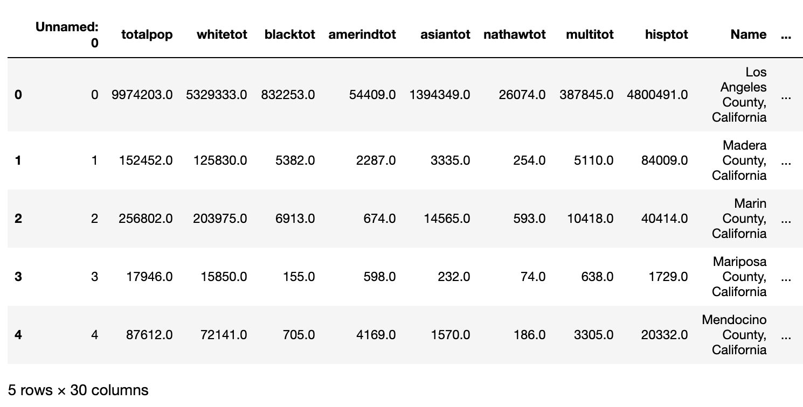
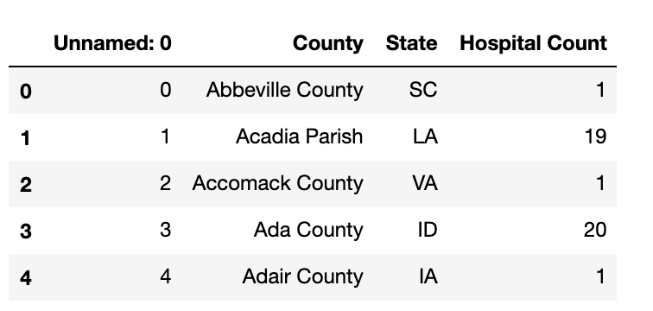
Slide 2
The Data
“Google Places API”
Fast Food within (20 mi. radius)
Hospitals (20 mi. radius)
“Census API”
Population of county
Population of ethnic groups in county
6

Slide 6
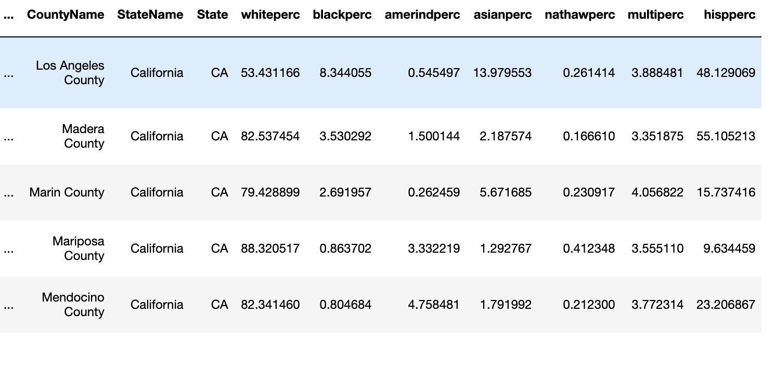
Slide 2
The Data
Heart Disease data from Kaggle
Population data from Census API
Hospital and Fast Food data from Google API
4

Slide 7
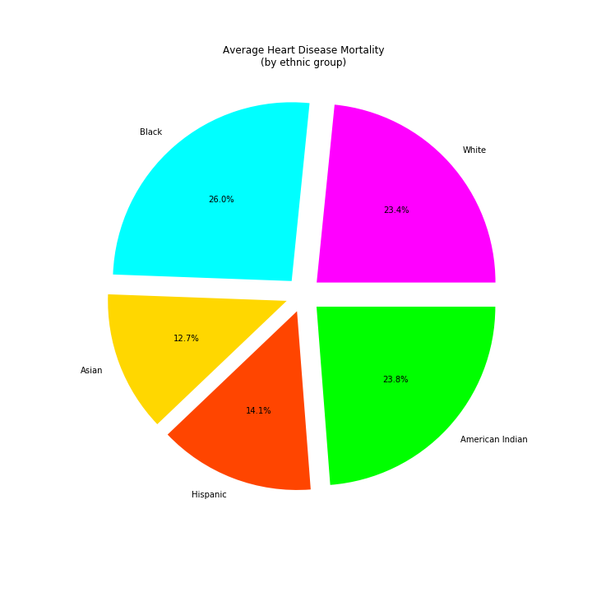
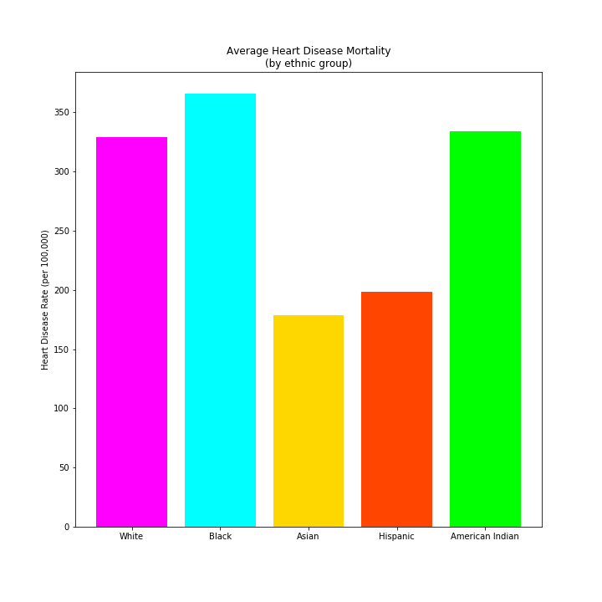
Slide 2
How does heart disease differ between racial/ethnic groups?
7

Slide 8
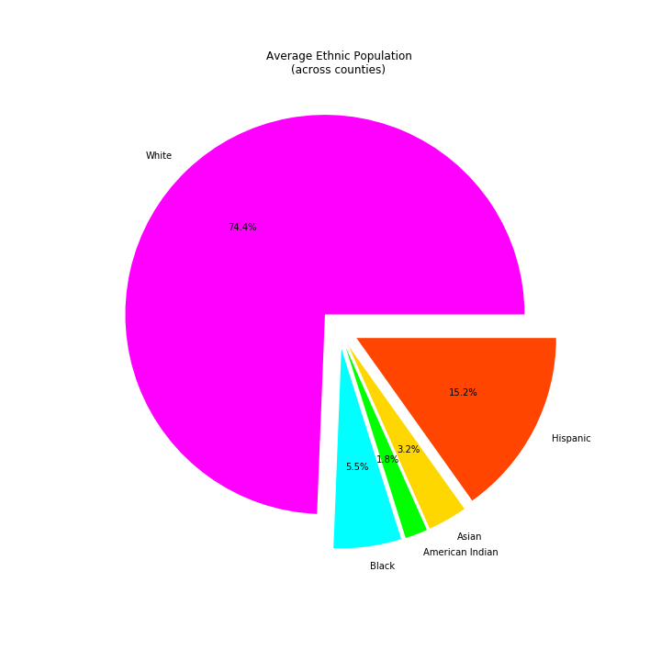
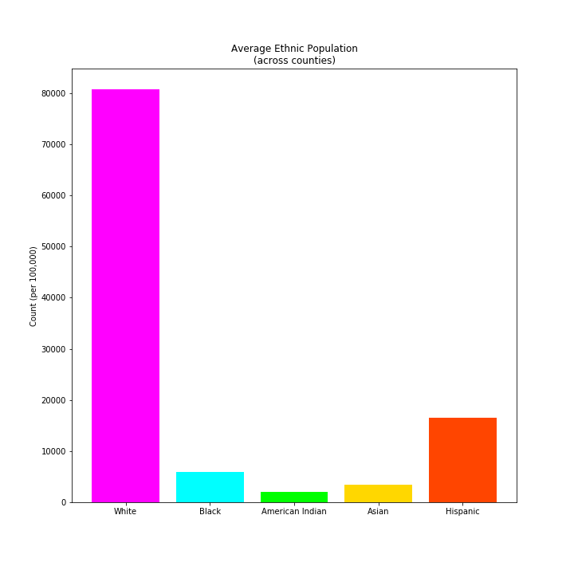
Slide 2
Is the rate of heart disease proportional to overall population for different ethnicities
8

Slide 9
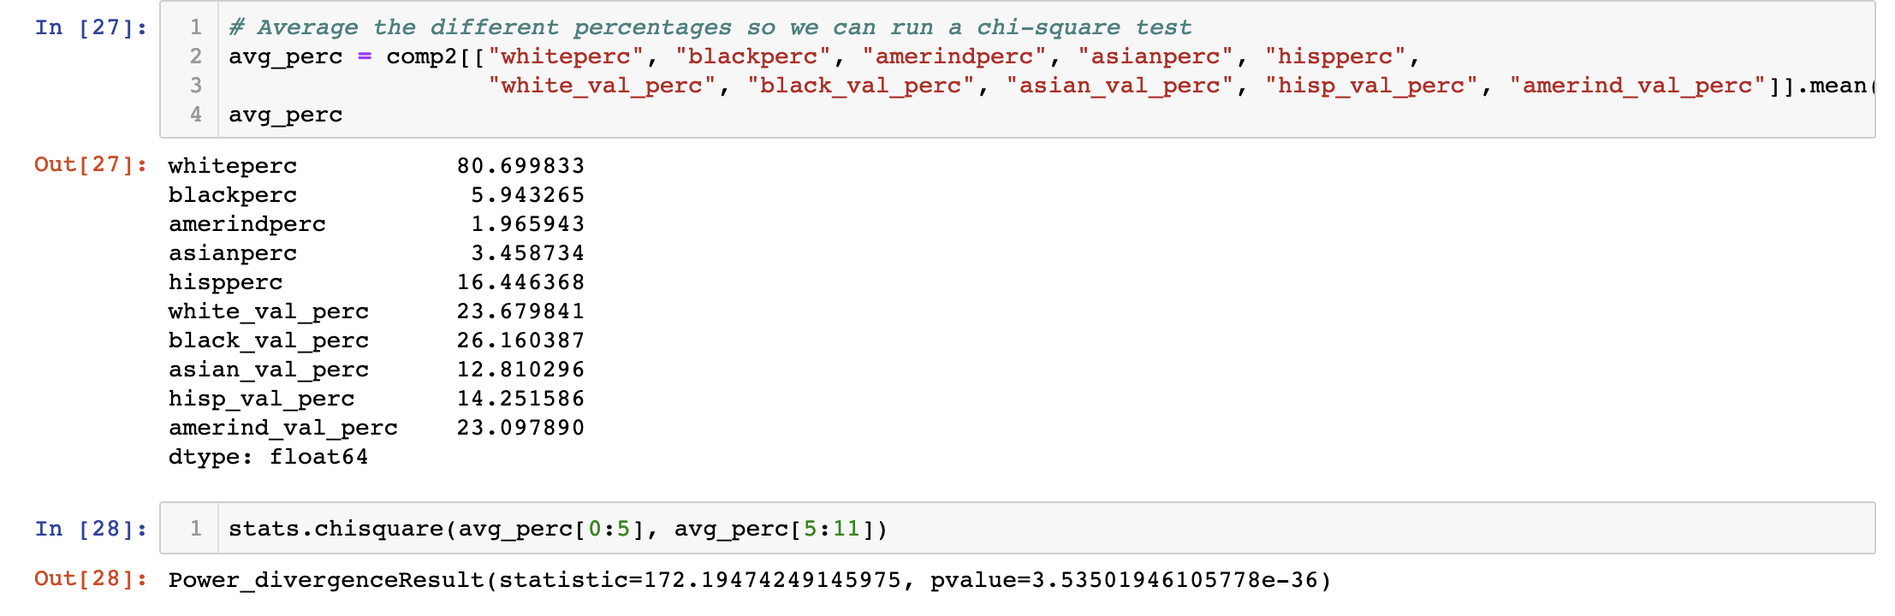



Slide 2
Is the rate of heart disease proportional to overall population for different ethnicities
8

Slide 10
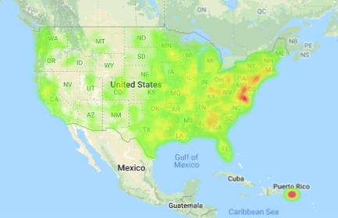
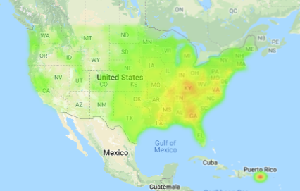
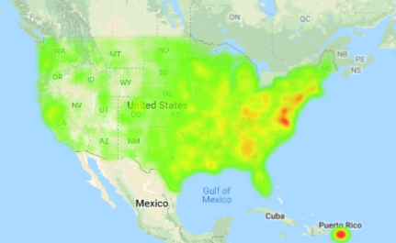

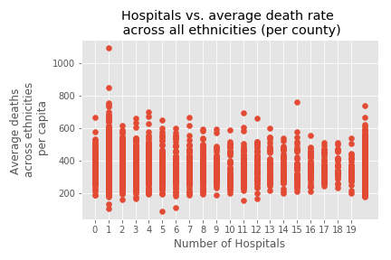
Slide 2
Is there a relationship between heart disease rates and number of available hospitals, regardless of ethnicity?
9

Slide 11
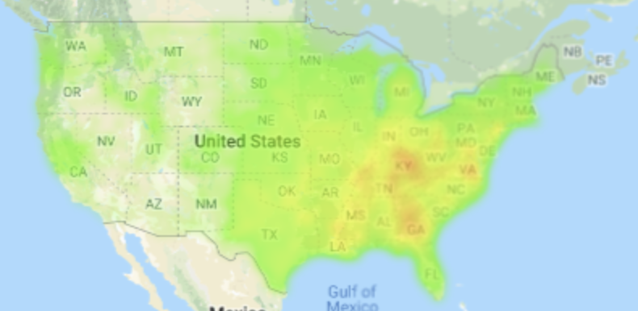
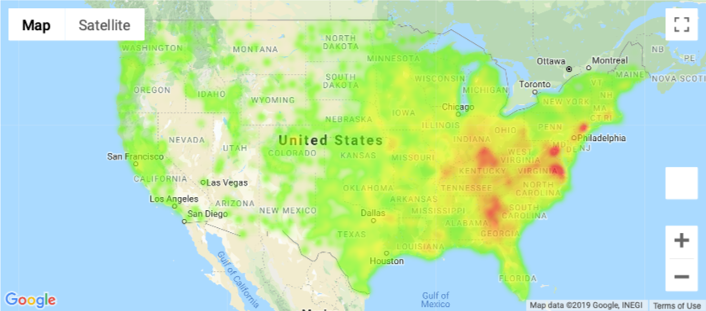
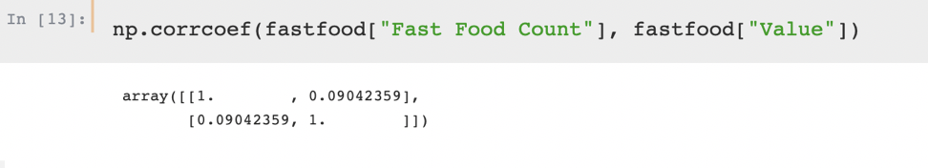
Slide 2
Is there a relationship between heart disease rates and number of available fast food restaurants, regardless of ethnicity?
Overall Death
Fast Food Count
10

Slide 12
Slide 2
Can heart disease be predicted by ethnicity, hospital availability, and fast food restaurant availability?
11

Slide 13
Slide 2
Limitations
API limitations
Data reduction due to incomplete alignment across datasets
2014 data
12

Slide 14
Slide 2
Conclusions
Heart disease disproportionally affects non-white ethnic groups
More data
Data reduction due to incomplete alignment across datasets
2014 data
13

Slide 15
Slide 1
Thank you!

Slide 16
Slide 2
Extra
Can heart disease be predicted by ethnicity, hospital availability, and fast food restaurant availability?
2

Slide 17
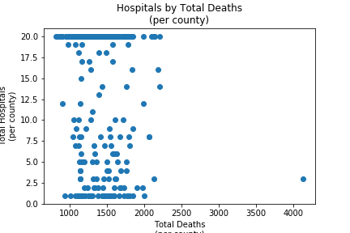
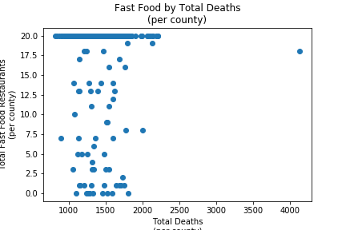

Slide 18

Slide 11
THANK YOU

